Slide 1
Lesson 4 – Servo and Colour Sensor
I buy all my colour sensors from the servo
Ben Schwarz

Slide 2
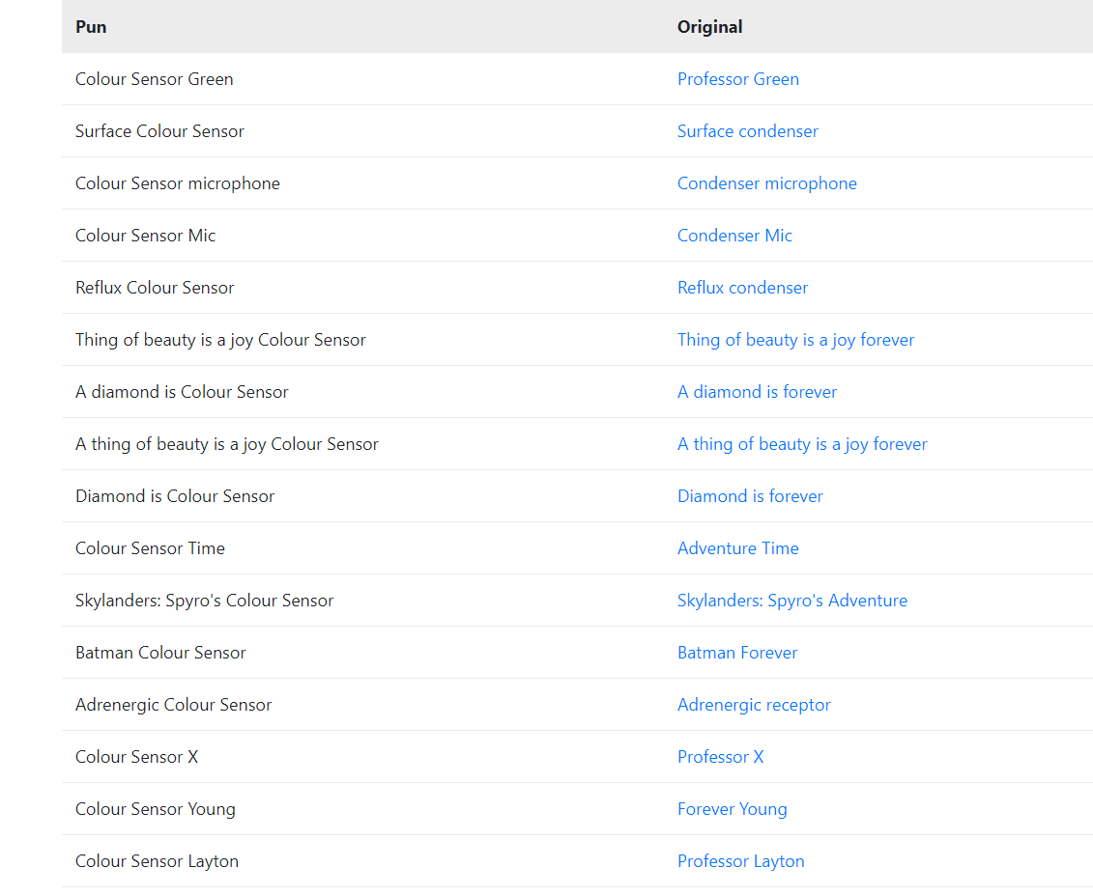
Before we start:
Found an auto pun generator. It was garbage

Slide 3
So how does a Servo work?
A Servo is a bit like a motor
It has a range it can move between
So how do we program it then?

Slide 4
How Stuff Works - Servo
To move the Servo you set the value of the servo to a value between (0-1)
The servo will then move it to the location which we want automatically after setting the position.
Before we set a position the servo will not try and move to one and no break is applied.

Slide 5
Set up
These two lines need to be placed in the Hardware class. You should know where they go by now.
public Servo servoC = null;
servoC = hwMap.get(Servo.class, "servoC");
I recommend placing the second line in a separate block along side other servos.
Changing Value:

Slide 6
Colour Sensor
A colour sensor allows us to identify colours.
So how do they work?
Two methods that are used:
Active: A Light flashes on and off. The sensor compares the difference in colour levels between the two to work out the actual colour without light. This is best used for identifying the colour of materials
Passive: The colour sensor simply absorbs the light and absorbs the colour. This is best for detecting which colour a light is.

Slide 7
Which Colour Sensor are we using?
The REV Colour Distance Sensor
It also doubles as a distance sensor (I’ve found it’s accuracy to be laughable)
It cannot change to passive mode.

Slide 8
Exercise: Code a working colour sensor:
^^^^ ~~~
(*<*) \ _(`~`)_/
,-|-’ | |
/ \ / \
It will output to the phone in teleOp

Slide 9
So what is recommended?
Sample Code is rather confusing
Simpler Approach works fine for what we need it for
First we need to create the colour sensor in Hardware Map
public ColorSensor sensorColor;
sensorColor = hwMap.get(ColorSensor.class, "sensor_color_distance");

Slide 10
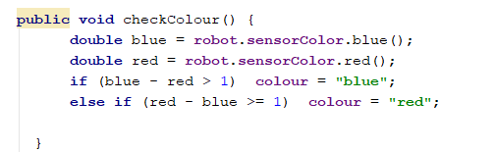
Using it
This is the function that I use for determining red or blue.
The subtraction is critical as it is about when determining it is about relatives. Is it more blue or more red.
Note: If you wanted the Hue than you need the fancy stuff in the sample.

Slide 11
But what about detecting a Yellow Cube
Obviously we can’t just compare some RGB, How would we do this?
Solution:
Read RGB Value
Convert to HSV
What is HSV: https://youtu.be/rLwOkAJqImo?t=12m43s
3. Check is Hue is in Threshold that you determine.(Possibly check if Saturation and Value are as well).
This threshold is important as different lights will affect the HSV values.

Slide 12
Activities:
There are 3 servos on the robot. Two for the arm and one to knock of the ball. Code these so that we can set the position by pressing a button on the controller. (for the arm only use one, otherwise there is a good chance you will break both servos)
Code the sensor to correctly identify if the ball is blue or red.
Implement both the servos and the colour sensor to knock the correct ball (Pick one servo and only use that one for the arm)
TIP: I Recommend storing the positions of the servo in the hardware map so that you can access them from any opMode.

Slide 13
But wait…. What about a yellow ball?
Doable but several steps:
First convert to HSV:
https://youtu.be/rLwOkAJqImo?t=645 (What is HSV)
2. Generate a tolerance of the hue angle
3. Detect if the object falls within the hue angle.

